Slide 1
Relation extraction using semantic web technologies
Ekal Golas
Navaneeth Venugopala rao
Prashanth govindaraj
Tejaswini sirlapu

Slide 2
Table of Contents
Introduction
Target Audience
Description of Data Sources
Data Integration
Data Product Results
Custom Project Justification

Slide 3
Introduction
This project is about relation extraction from unstructured business data using semantic web technologies.
It aims to derive unstructured data from the web and process content in the data to find entities and relationships.
These entities and relationships, modelled by a semantic ontology, organizes the content in the data to a structured format.
The results are then displayed on to a website, where the user can search for different entities and obtain relationships and linked information about that entity.

Slide 4
Target Audience
Financial/Marketing analysts – As a relation between entities and the money is developed, the structured data can be used to answer queries based to money involved with a person or an organization
Statistical users – This structured data can be queried to obtain statistics around a region, person, organization or location
Random web user – A random web user can browse this website instead of browsing the web to find unstructured information, and find relationships and linked information about a person or an organization in one place.

Slide 5
Description of data sources
The data is described as:-
A collection of web pages, indexed and stored in SolR
Data will be about people, organizations, locations and related financial information
Initially we took a small sample of test data, and then scaled out. For this report, the sources used are:-
https://en.wikipedia.org/wiki/Bill_Gates
http://www.biography.com/people/bill-gates-9307520
http://www.bloomberg.com/news/articles/2015-11-22/bill-gates-hopeful-china-will-amend-laws-to-boost-philanthropy
Data is available publicly on the internet

Slide 6
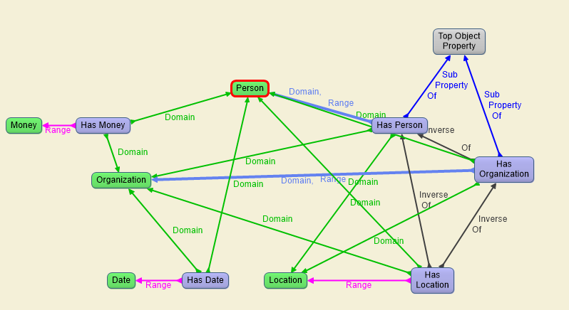
Custom Ontology Description

Slide 7
Data Integration
Data is integrated in the following steps:-
Firstly, a set of documents and content is stored in Apache SolR
Then this data is read from SolR and fed into Stanford CoreNLP API to tag the data with various properties
The entity tags and related data are then fed into Apache Jena, which reads the custom ontology in Figure 1 above as RDF/XML, and transforms the data tagged with entities into structured data stored a RDF and N-triples files
These files are then read into a website and the results are displayed to the user
This integration from end-to-end provides the experience of transformation of unstructured data scattered over the web into a structured, linked format that the user can make sense of and derive meaningful information from.

Slide 8
Data Product Results
Following was the expected results of this project:-
Getting an insight as to how people, organization and locations are related to each other.
Possible financial information related to these results
Visualization of this data as a graph
These results are interesting because scope of this project can help marketing teams make better sales/business decision based on extracted relationships and structures data visualizations. Even casual users might benefit by gather general knowledge from this data about companies and famous personalities.

Slide 9
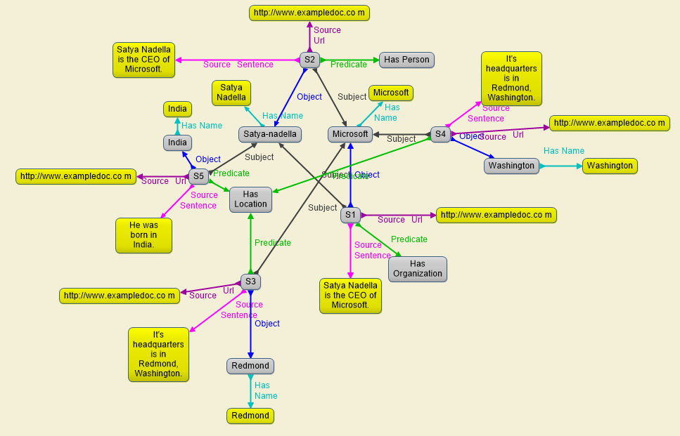
Sample visualization graph

Slide 10
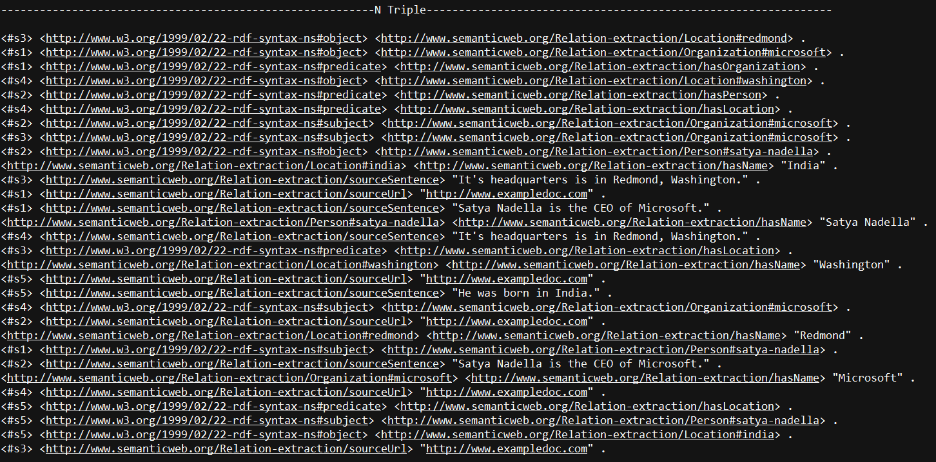
Graph stored as N-triple format

Slide 11
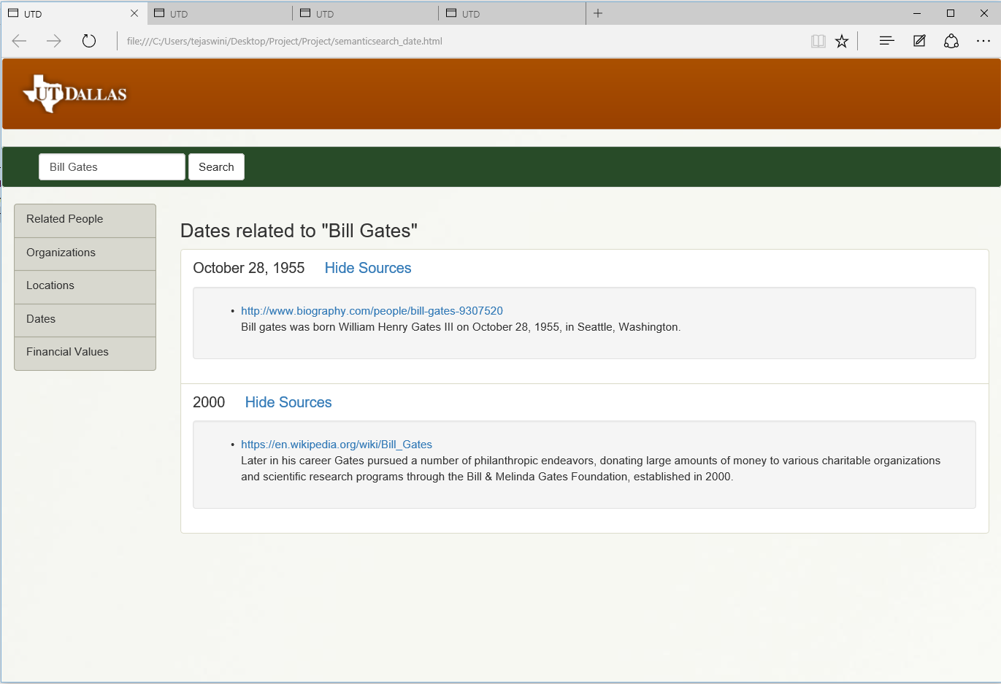
Person to Date Relation

Slide 12
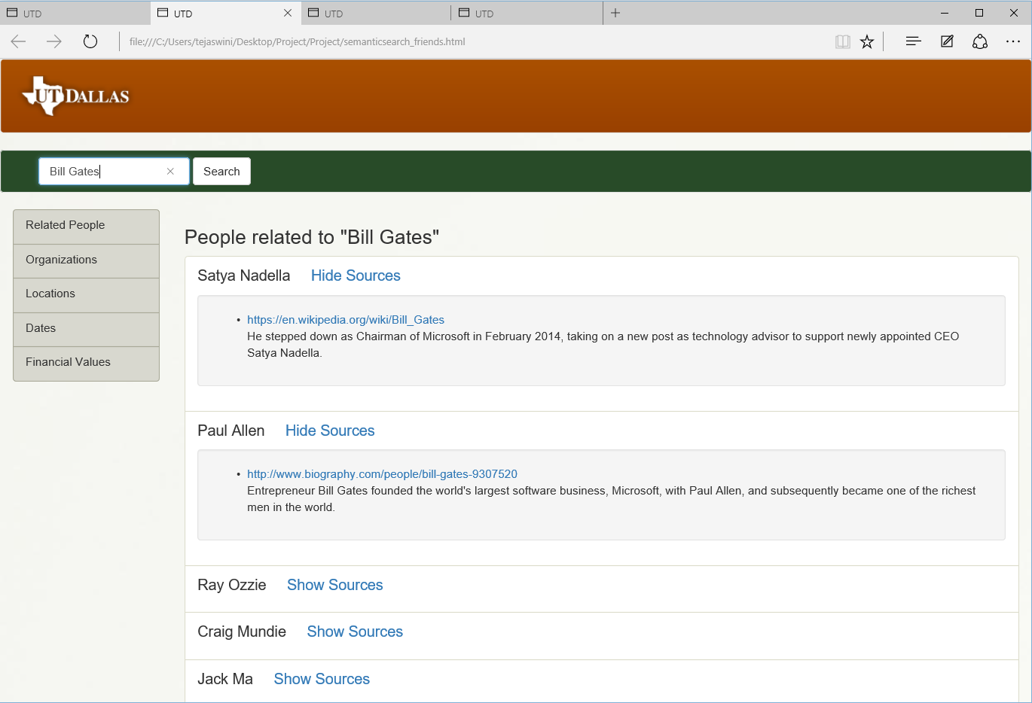
Person to People Relation

Slide 13
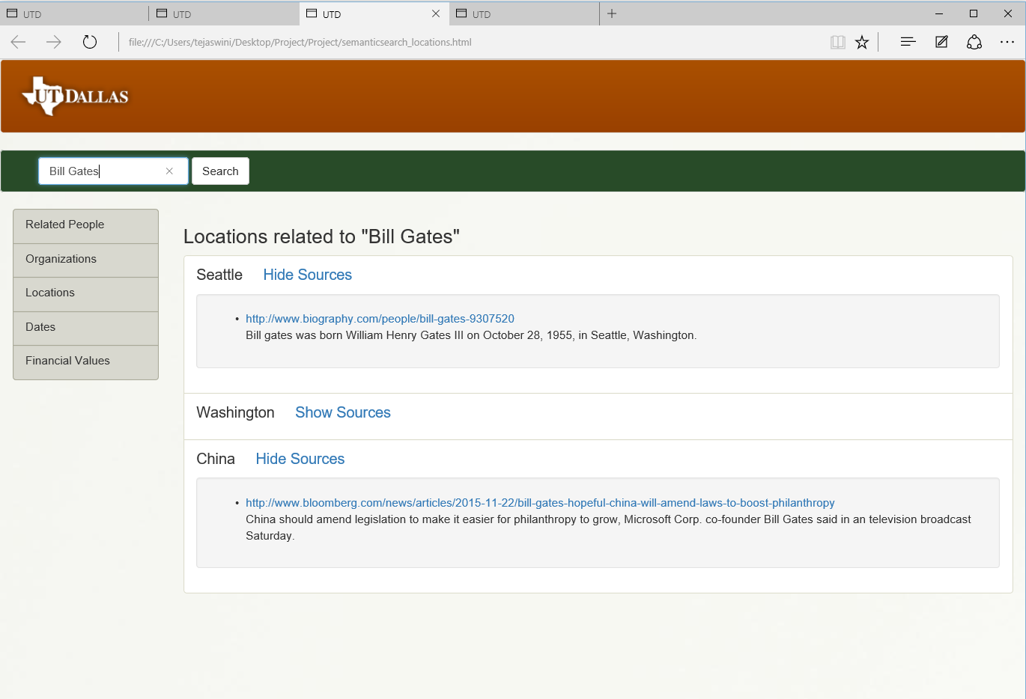
Person to Location Relation

Slide 14
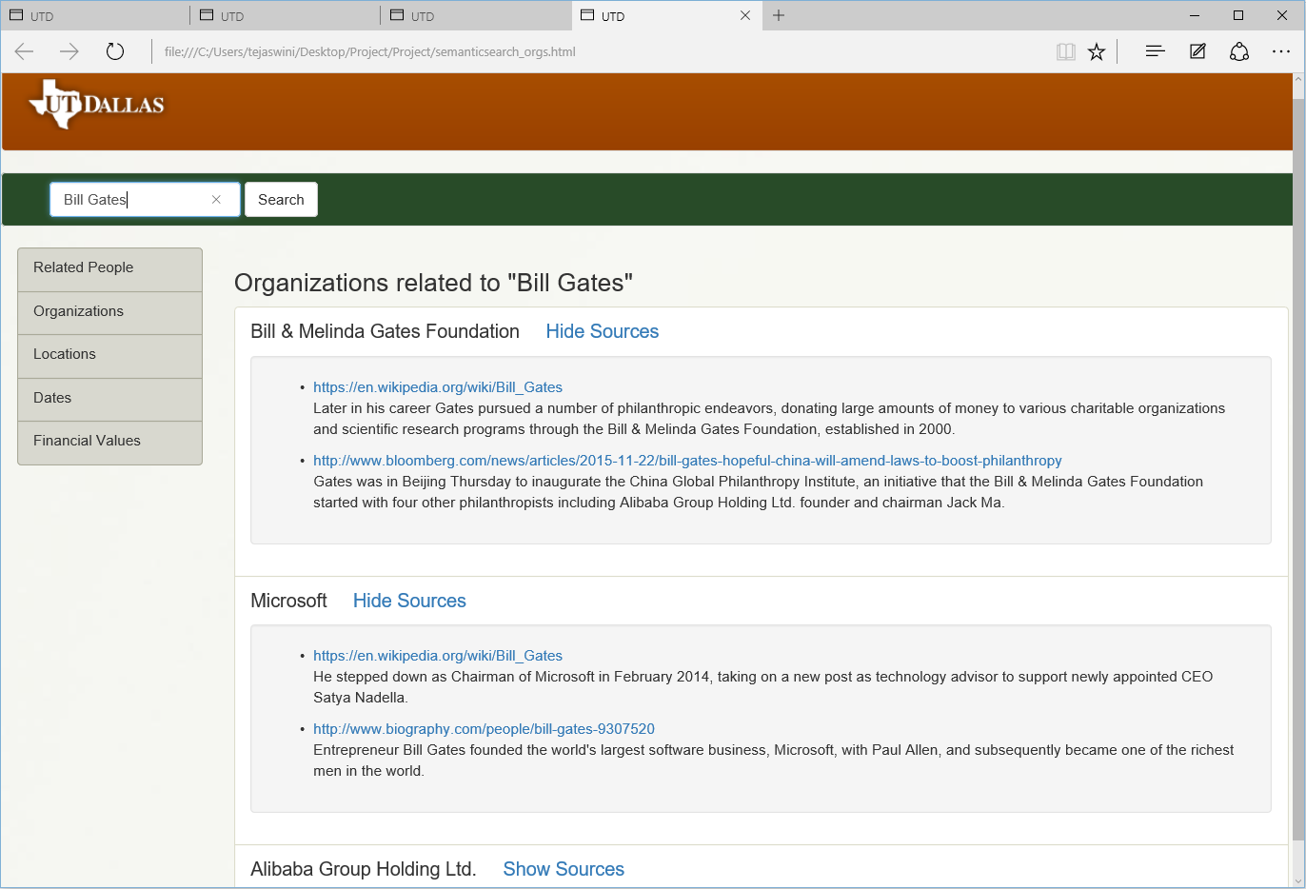
Person to Organization Relation

Slide 15
Custom project Justification
This project differs from an LOGD project in the following ways:-
Different source of data – The LOGD website was not used as the data source
Wider range of tools used – Including the use of Jena, Gruff, Protégé, other technologies like SolR, HTML, CSS, JavaScript, Java, Stanford API were also used for end-to-end integration
Custom Ontology – A custom ontology was defined to model and structure the data and the results displayed were structured using this model.

Slide 16
Summary
As discussed, this project successfully extracts relations in unstructured data using Semantic Web technologies.
As shown in the figures, these relations in the data and successfully displayed on a website for the user to derive meaningful information from.
The report also described the relevance of these results, the target audience for whom these result may prove to be relevant and the justification for this custom project.
Although a small sample of data, the project can be scaled to much larger size of data and can present to the user a much wider expanse of entities to search and derive structured information about.

